Slide 1
Communication in Data Science
A Picture Speaks a Thousand Words!
Michelle Helfman
6/2/2022

Slide 2
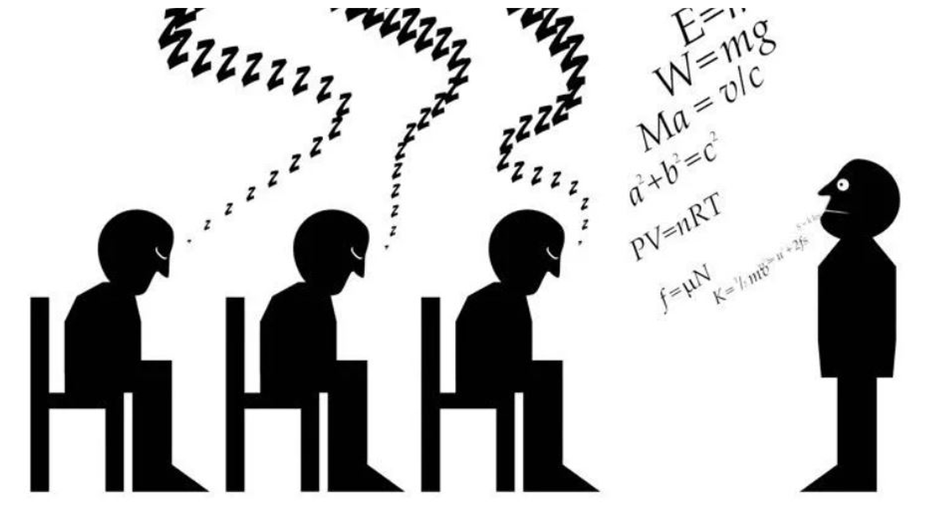
Total Motorcars Jeep Sales Figures
You’ve gathered the sales figures and crunched the numbers and it’s time to present the results to management.
2018 was the best year for Cherokee sales with 392 vehicles sold.
41 Jeep Renegades sold in 2021.
Jeep Wrangler had the most consistent sales throughout the past 5 years.
You can stand in front of a group and talk about facts and figures or you can VISUALIZE it.

Slide 3
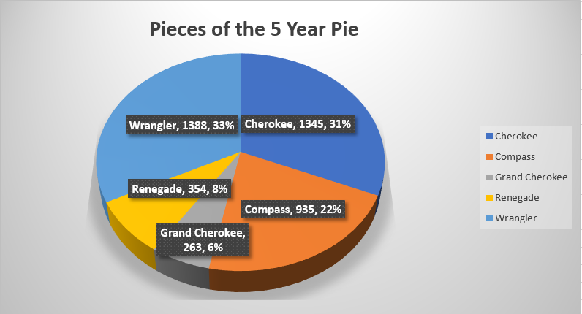
Total Motorcars 5 Year Sales Totals
5 Years of sales figures in 1 diagram.

Slide 4
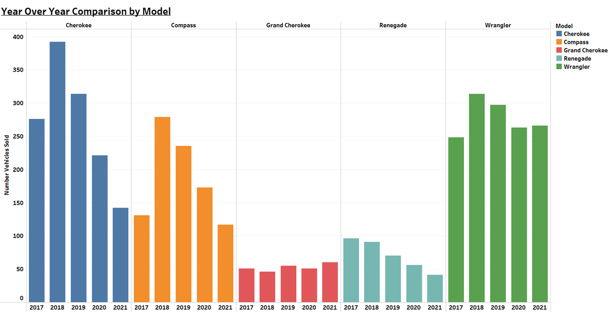
Total Motorcars Yearly Sales by Model
You can see the pieces of the pie chart by year.

Slide 5
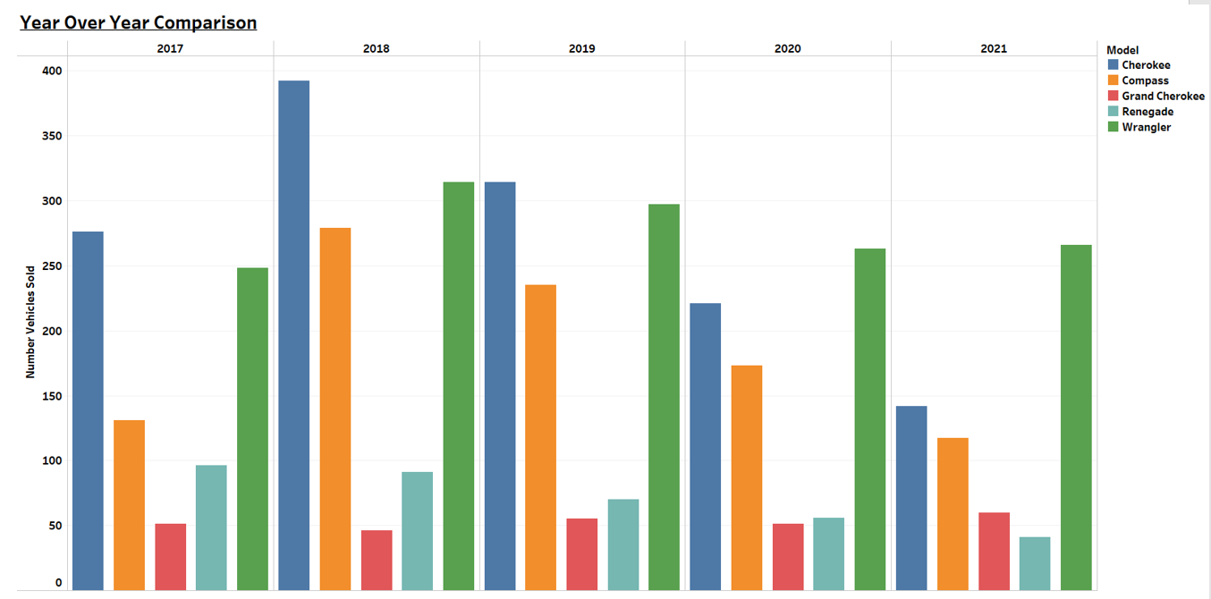
Total Motorcars Yearly Sales by Model
Same data different point of view.

Slide 6
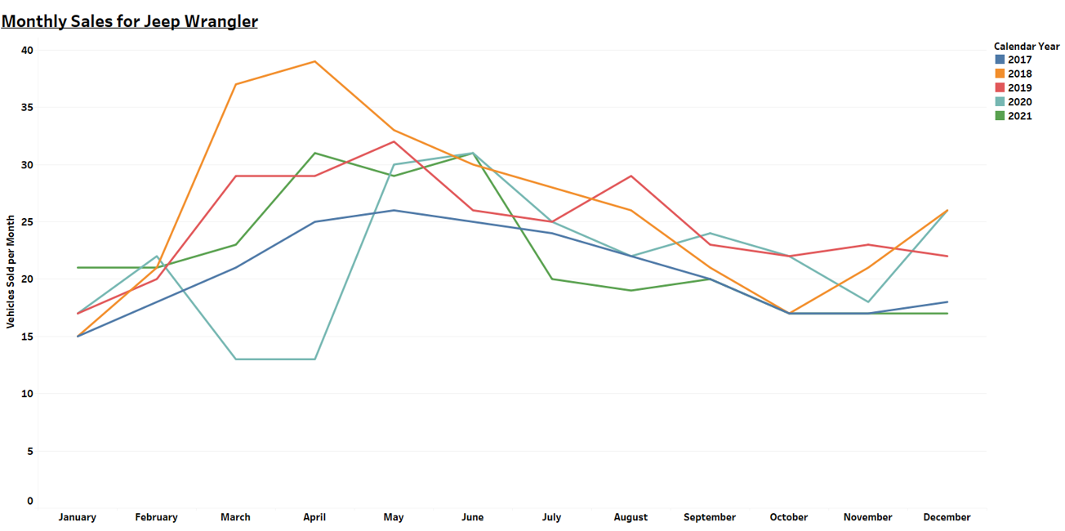
Total Motorcars Monthly Comparison by Model
You can look at the yearly details by month and model.

Slide 7

“Every Picture Tells a Story”
Rod Stewart & Ronnie Wood
With Visualizations you can.
See the same information in different forms
See the big picture and the small details
Words go in one ear and out the other, but pictures get remembered
Keep your audience engaged and interested
Create Outstanding Presentations!!!
Information for presentation only, not actual sales data.

